Slide 1

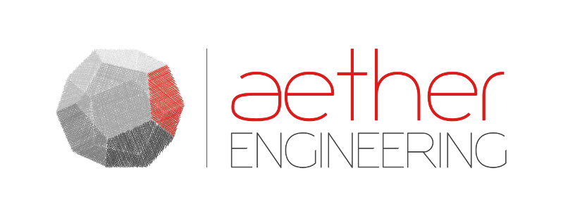
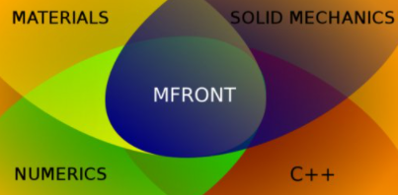
MFront, Code_Aster and Wood: mechanical behaviors applications in structural design and cultural heritage conservation
Lorenzo Riparbelli¹, Ioannis P. Christovasilis², Marco Fioravanti¹
¹ University of Florence, DAGRI, Florence, Italy
² Aether Engineering, Florence, Italy (ipc@aethereng.com)

Slide 2
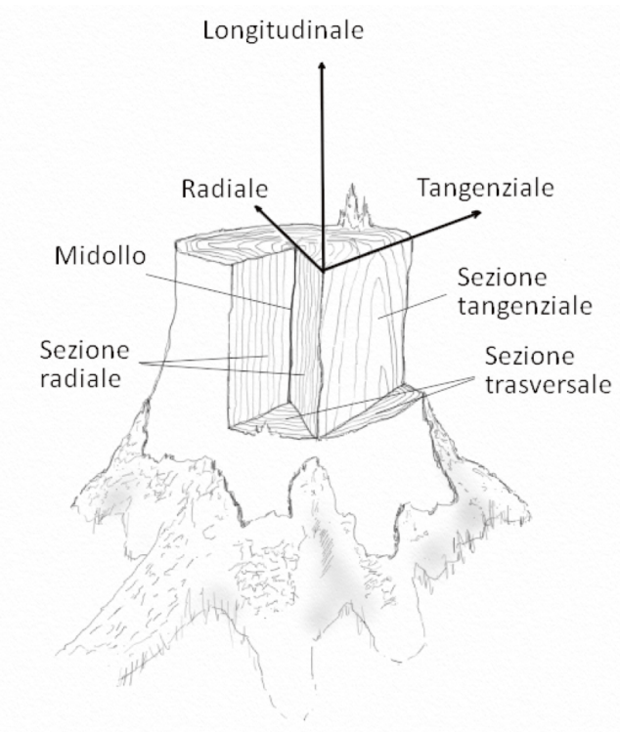
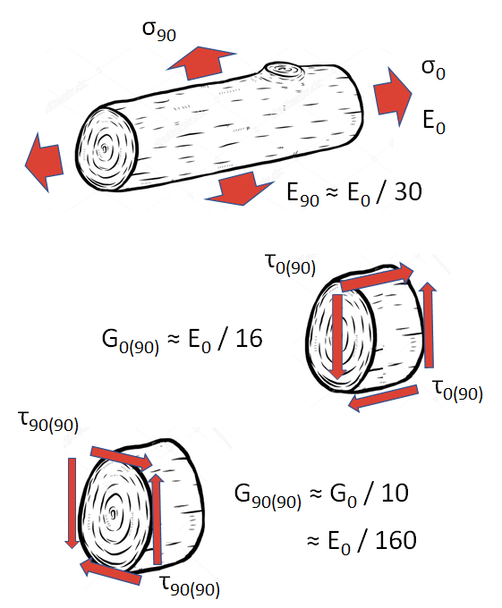
WOOD – Anisotropy of elasticity
LONGITUDINAL
E~15000MPa
RADIAL
E~1000MPa
TANGENTIAL
E~500MPa
PITH
TANGENTIAL SECTION
RADIAL SECTION
TRANSVERSAL SECTION
SOURCE: BONAMINI, UZIELLI, MANUALE DI SCIENZA E TECNOLOGIA DEL LEGNO, CLUT 2021

Slide 3
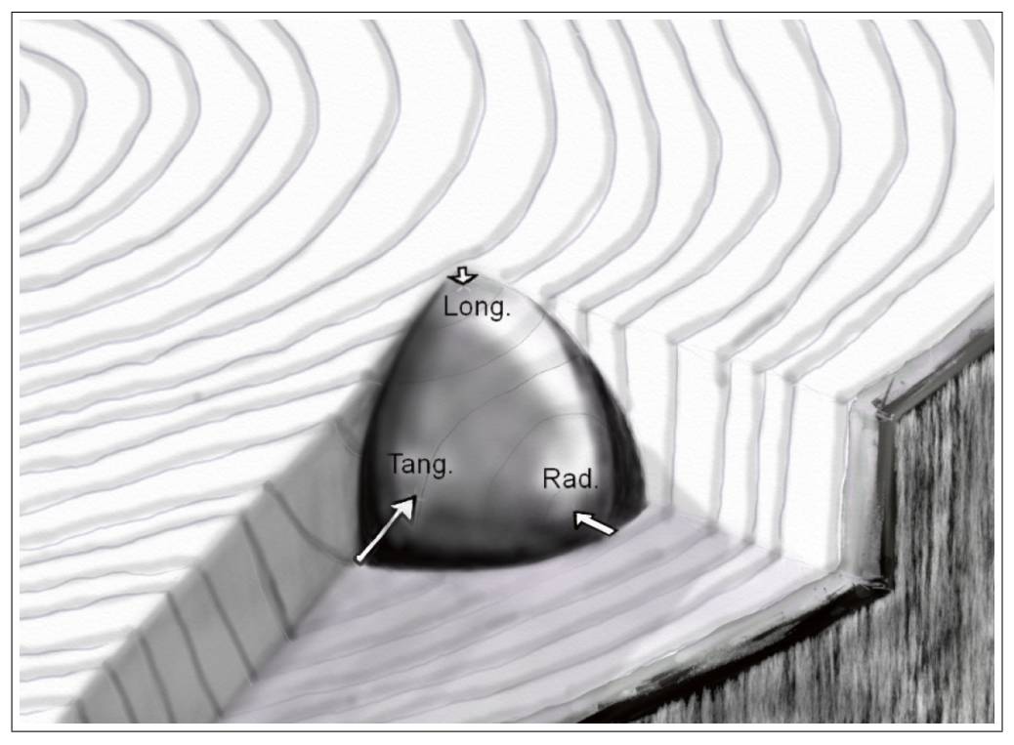
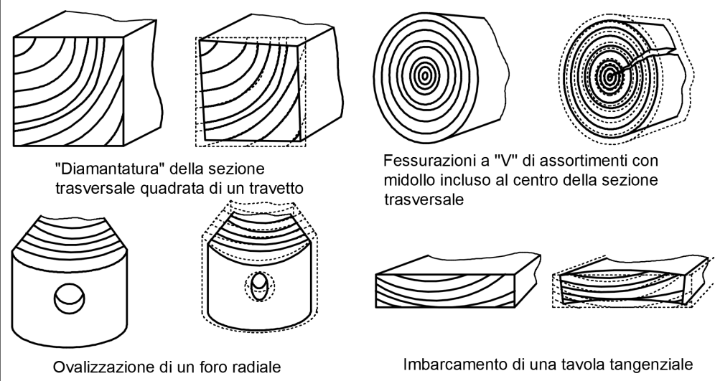
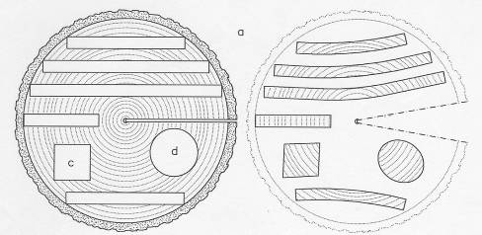
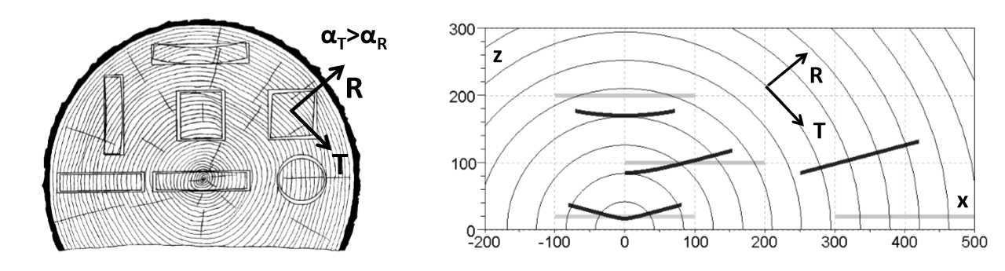
WOOD – Anisotropy of shrinkage
SOURCE: BONAMINI, UZIELLI, MANUALE DI SCIENZA E TECNOLOGIA DEL LEGNO, CLUT 2021

Slide 4

Law of behaviour – Mfront + CA
Field of Moisture
Field of Geometry
FEM Solution in cylindrical coordinates

Slide 5
Field of moisture – generated a priori
Code Aster – Isotropic Fick Diffusion
Syrthes – Orthotropic Fick Diffusion – Coupled Heat Mass Transfer
Code Aster – Analytical or tabled definition

Slide 6
Field of geometry – generated by CA
Code Aster – Read the x,y,z field for a given mesh
y
T
Code Aster – Create the nodal field of angle
R
x₀,y₀
α
x

Slide 7
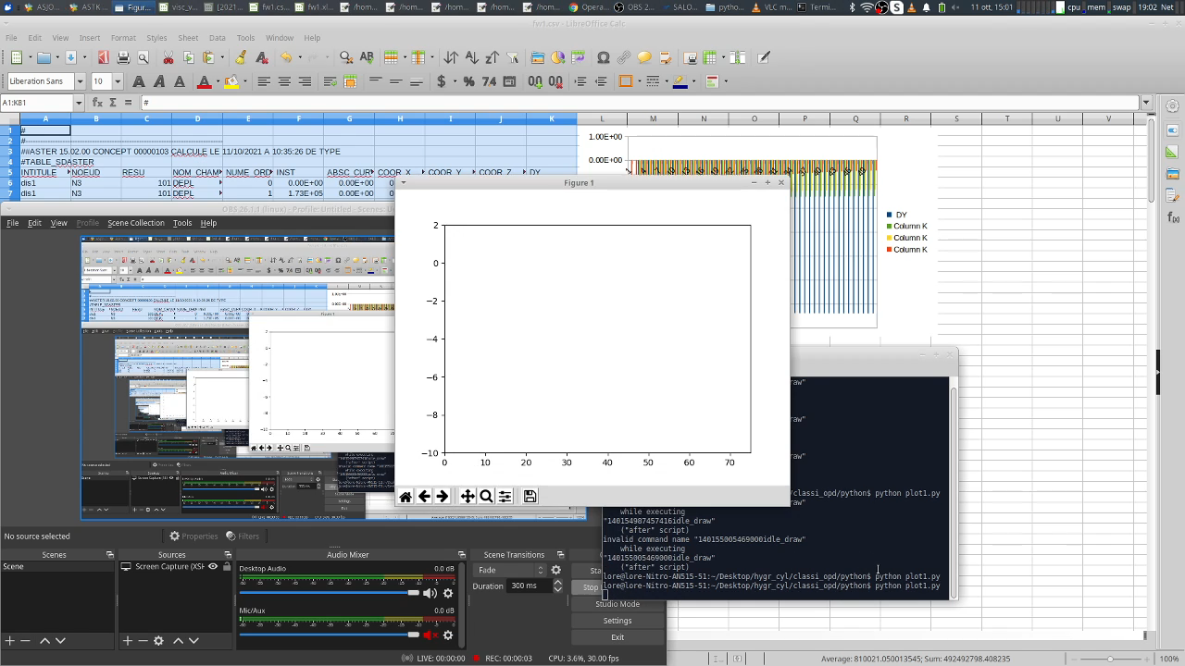
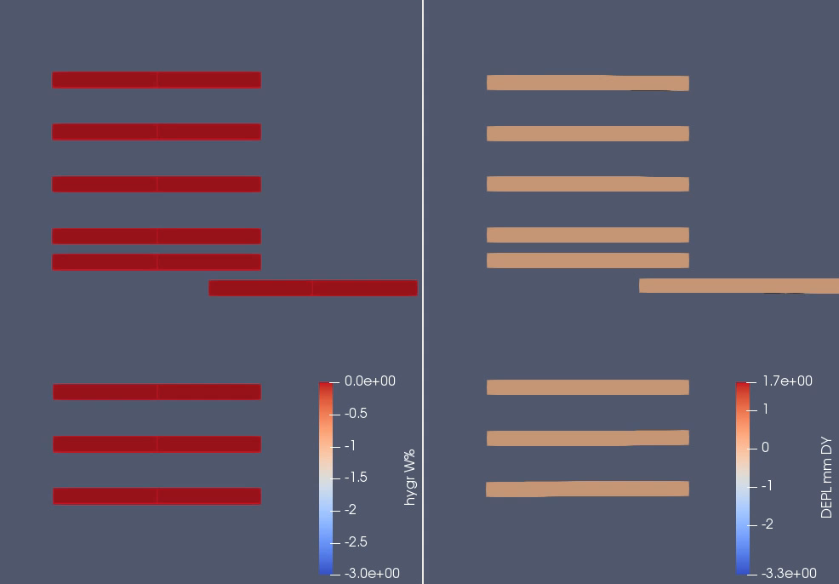
Shrinkage deformations
Pith
Pith
Δw=-3%
~ -20% RH
Δw=-3%
~ -20% RH

Slide 8
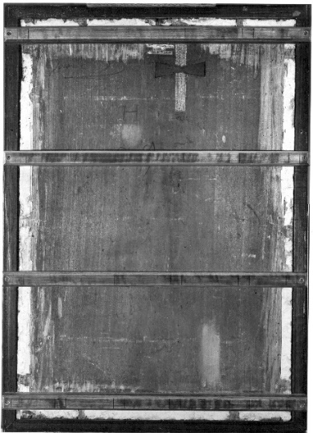
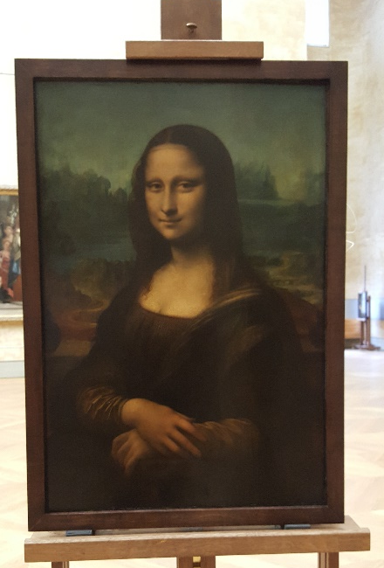
Panel Paintings
Painted
Layers
Ground Layers
Wooden Support

Slide 9
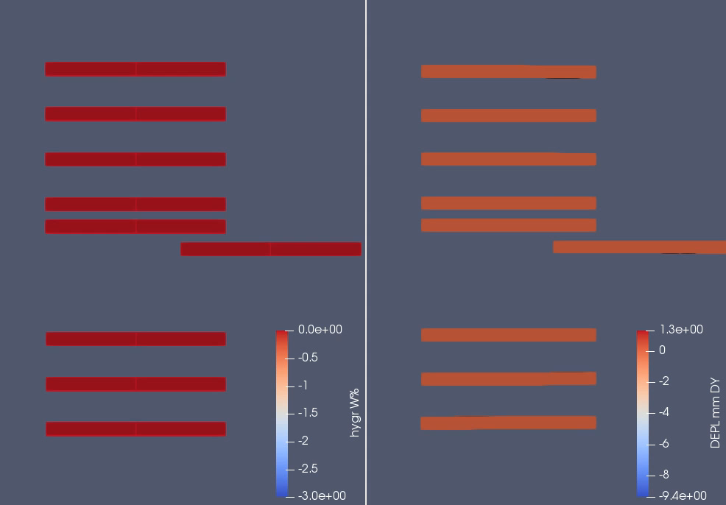
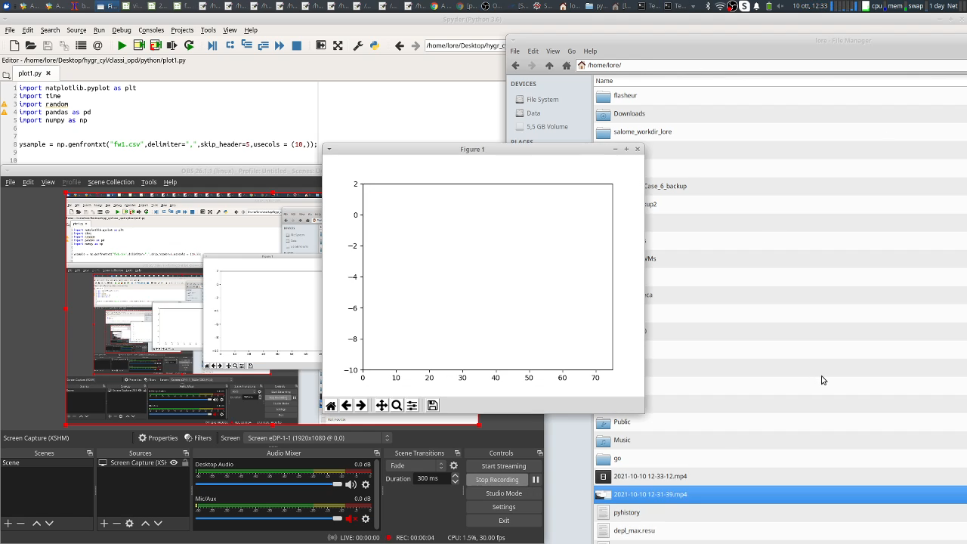
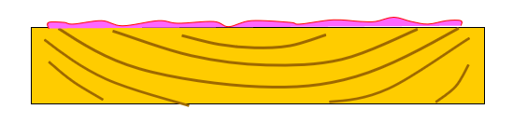
Shrinkage deformations – Flying wood
Pith
Pith
Δw=-3%
~ -20% RH

Slide 10
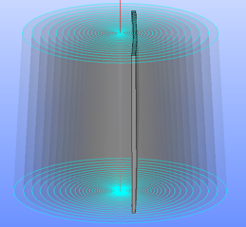
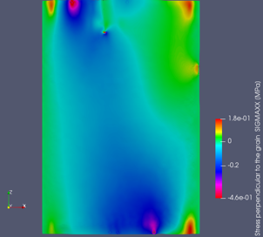
The Mona Lisa
Project coordinator: Joseph Gril, CNRS Clermont Fd
Research Groups involved: LMGC Montpellier, Pprime Poitiers, Institute Pascal Clermont Auvergne, DAGRI University of Florence, C2RMF, Louvre Museum, Restorers
SOURCE:
Riparbelli L et al. Mona Lisa’s digital twin: identifying the mechanical properties of the panel combining experimental data and advanced finite-element modelling, 7èmes journées du GDR Sciences du bois, Nov 2018, Cluny, France.
Riparbelli L. et al. Studies for the Mona Lisa conservation: the implementation of its panel’s Digital-Twin. CompWood. Växjö, Sweden.

Slide 11
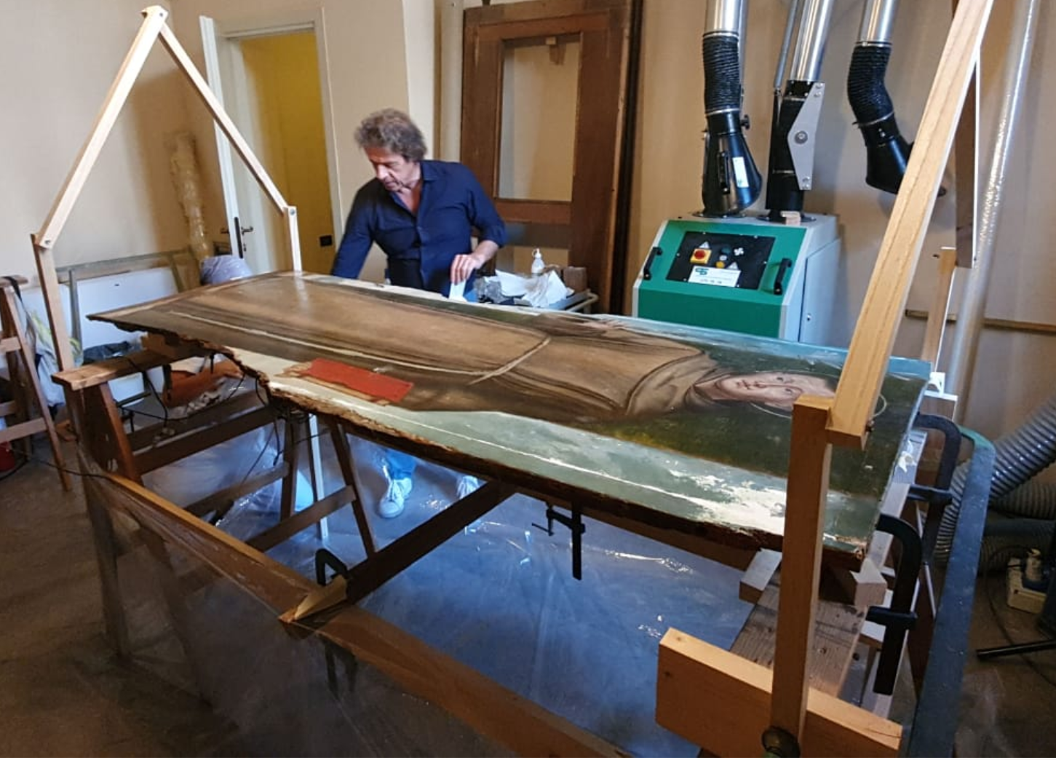
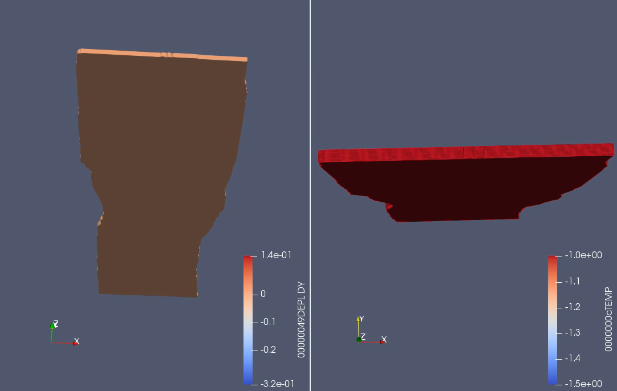
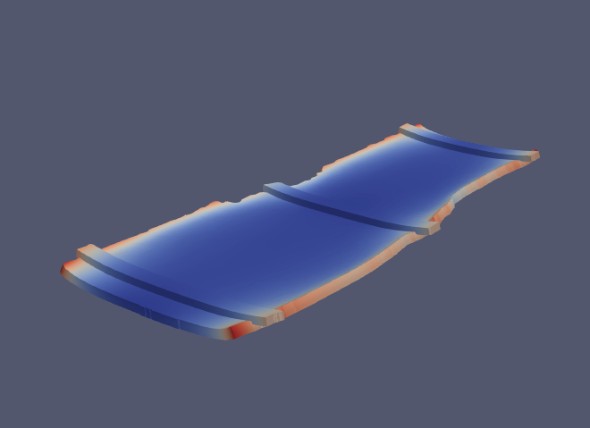
Sant’Antonio
Collaboration between DAGRI University of Florence, Opificio delle Pietre Dure, AR Arte e Restauro

Slide 12
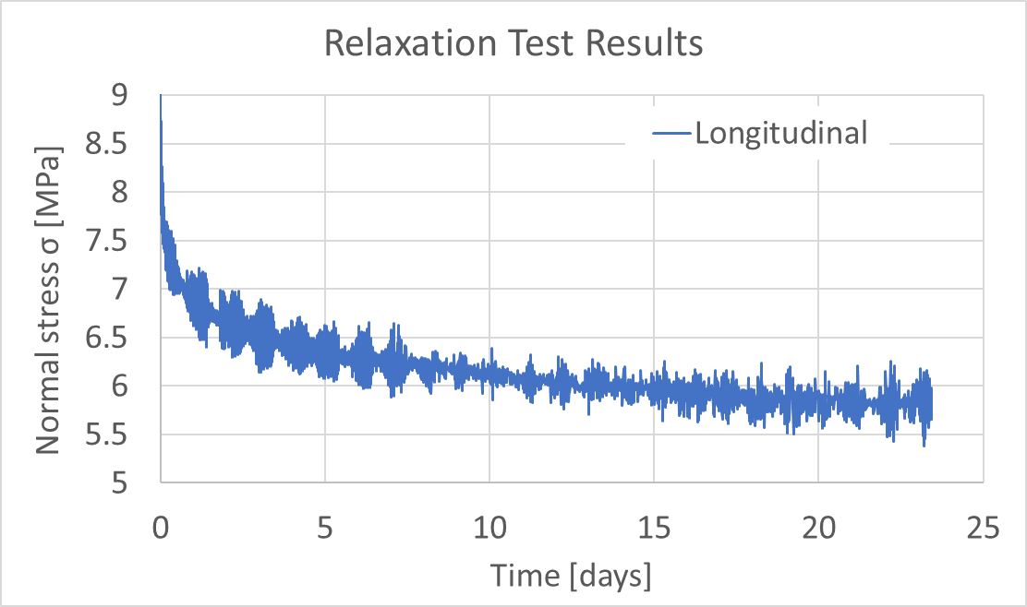
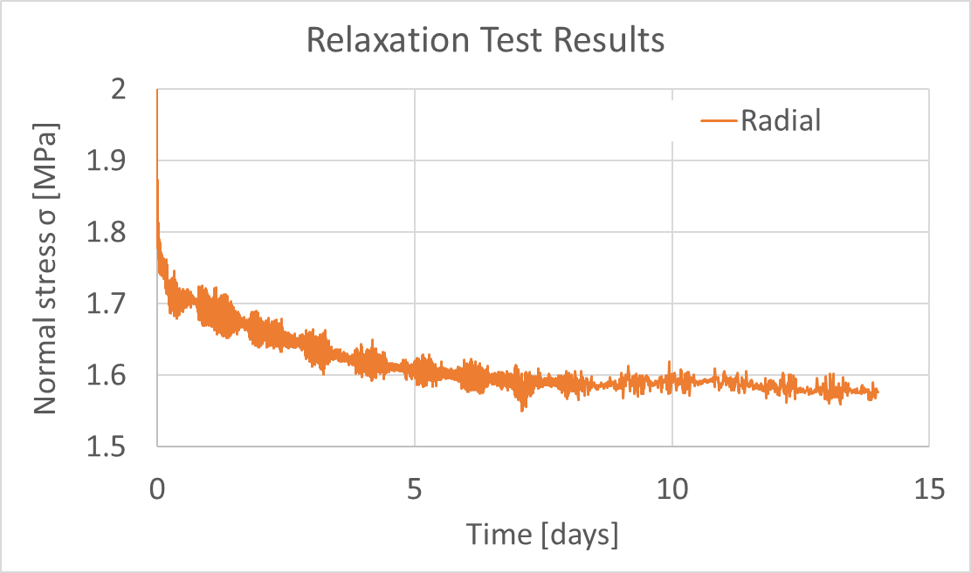
Viscoelasticity in Wood
Orthotropic viscoelastic behaviour
Δ
t

Slide 13
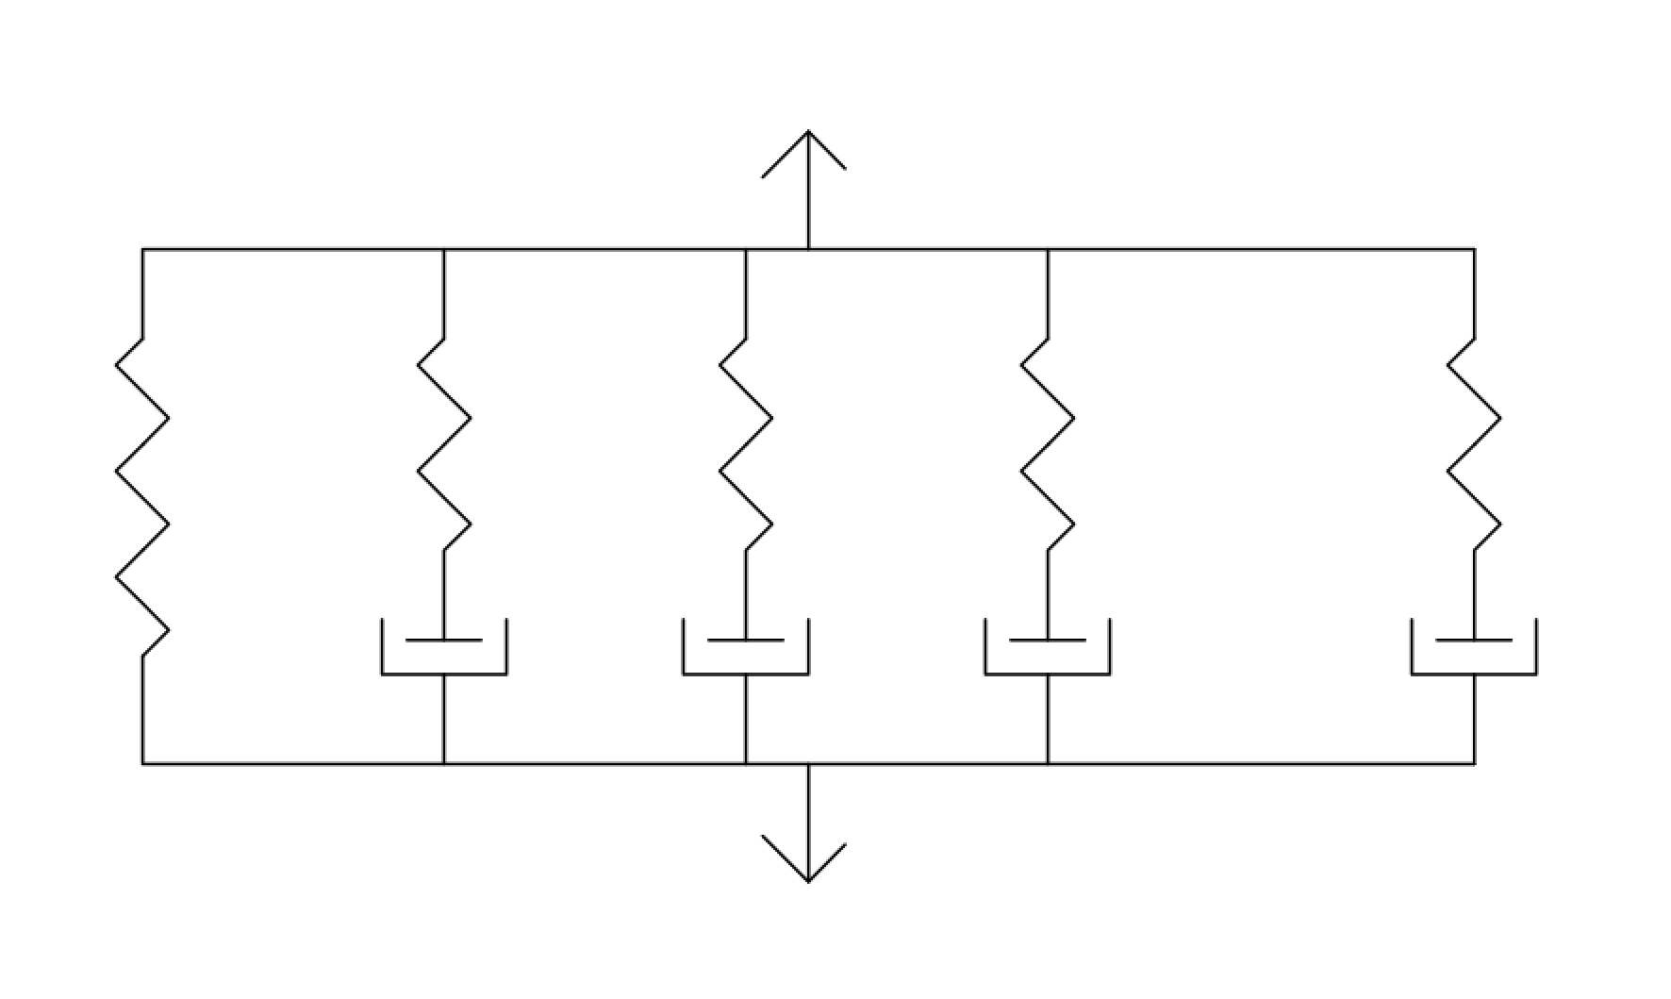
Viscoelasticity with MFront
Orthotropic generalized Maxwell model
Any number of characteristic times
For any of the 9 constitutive properties of the orthotropic behaviour

Slide 14
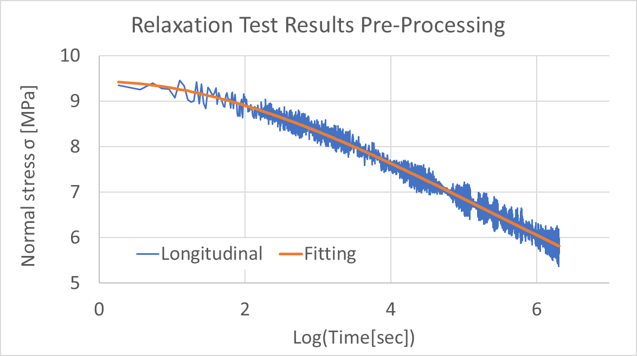
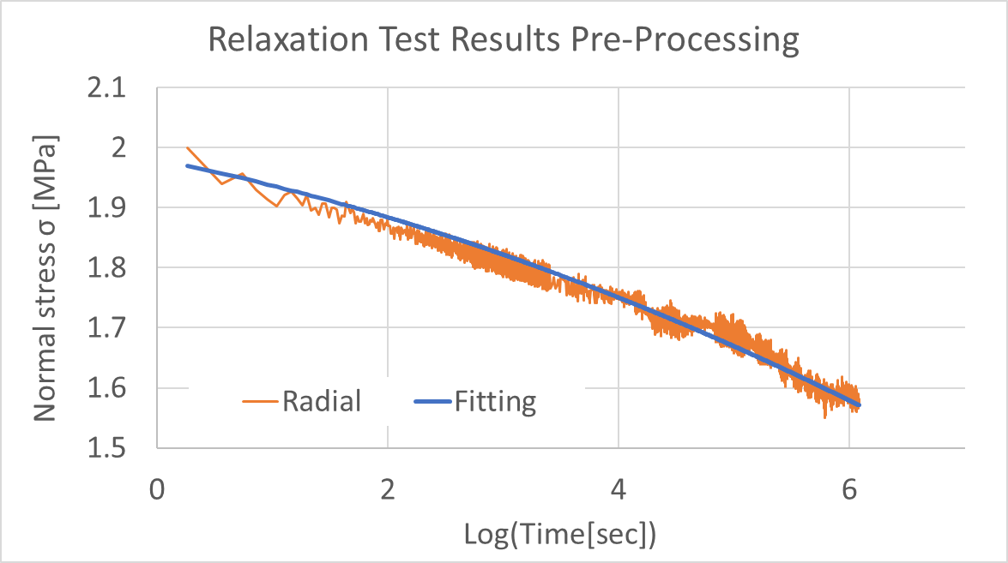
Material Property Estimation
Data filtering and reduction of data points for parameter fitting

Slide 15
Material Property Estimation
Parameter estimation using MACR_RECAL and SIMU_POINT_MAT in Code_Aster
5 characteristic times: 10², 10³, 10⁴, 10⁵, 10⁶ sec
6 total fitting parameters for each case

Slide 16
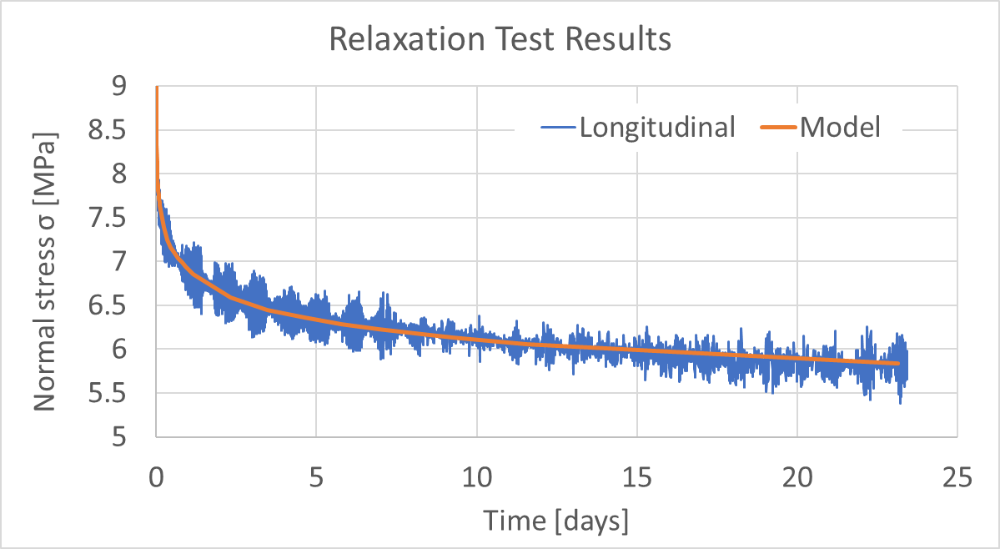
Material Property Estimation
Longitudinal Direction

Slide 17
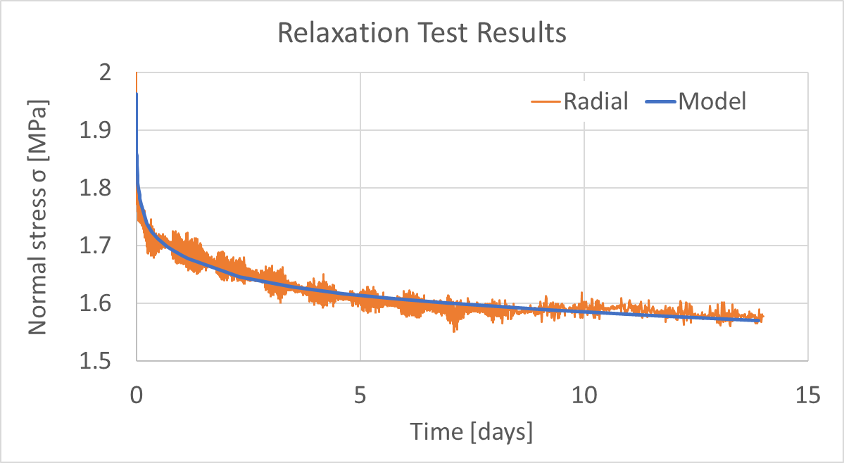
Material Property Estimation
Radial Direction

Slide 18
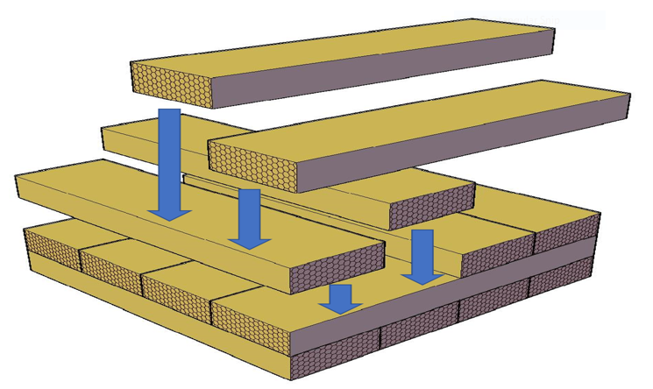
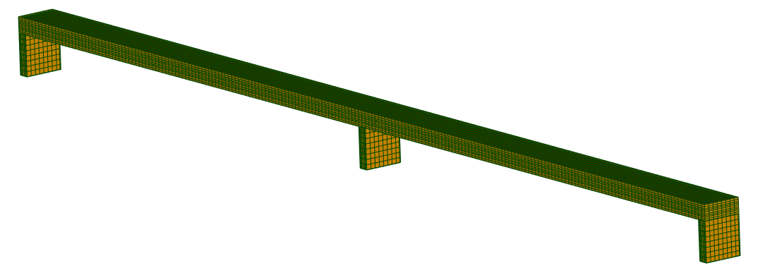
Viscoelasticity Example
Cross Laminated Timber (CLT)
5m
5m

Slide 19
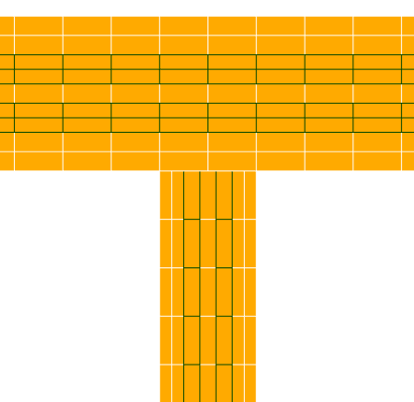
Viscoelasticity Example
Cross Laminated Timber (CLT)
L
T
L
T
L
5m
5m

Slide 20
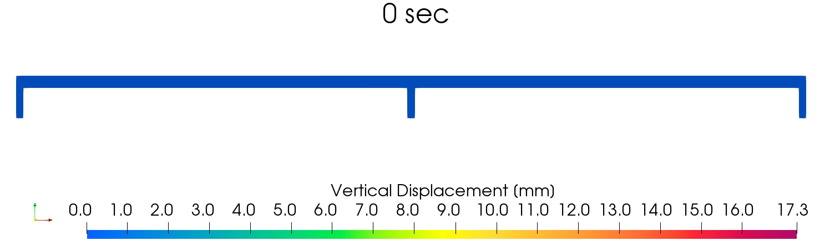
Viscoelasticity Example

Slide 21
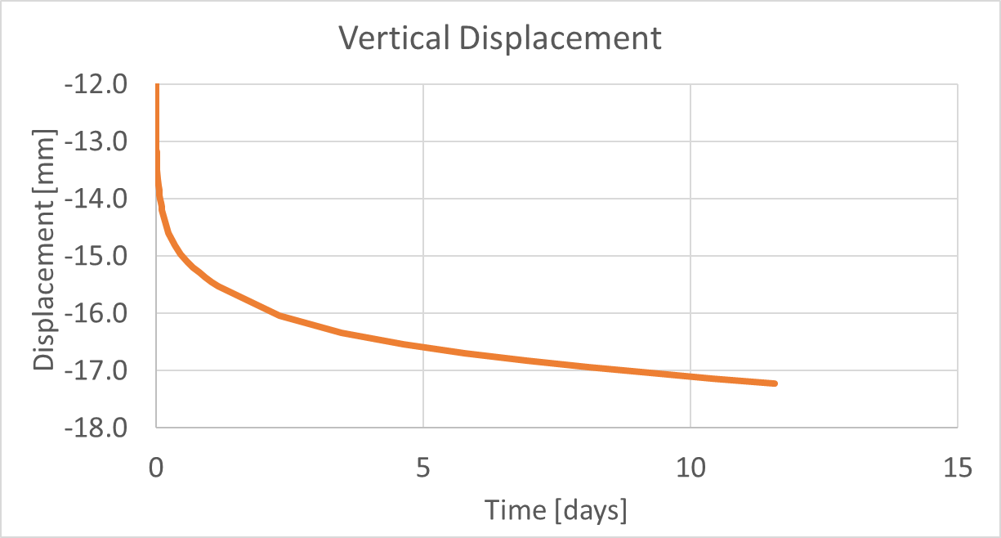
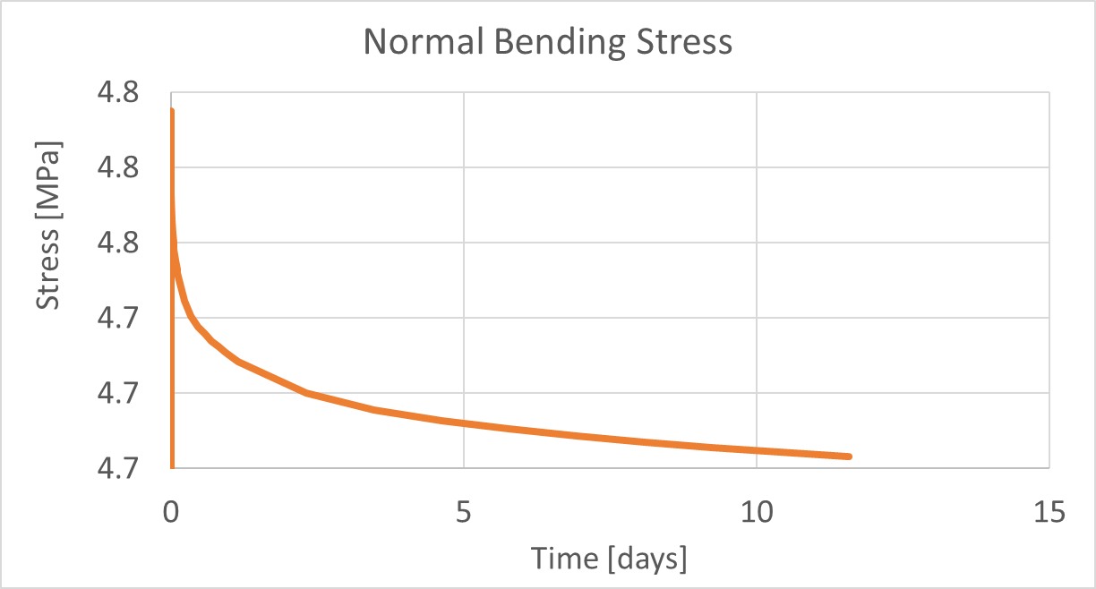
Viscoelasticity Example

Slide 22

Thank You!

